Slide 1
Zomato Restaurant Analysis
Puja Archana Sahu 10/05/2024

Slide 2

About Zomato
Zomato is a food delivery and restaurant discovery platform that operates through a user-friendly mobile app and website, acts as an intermediary between users and restaurants, providing a convenient platform for discovering, ordering and enjoying food from a wide range of dining establishment.
Objective:
The aim of this project is to conduct a comprehensive analysis of Zomato’s market positioning to get a fair idea about the factors affecting the establishment of different types of restaurant at different Countries and cities.

Slide 3

Dataset summary
Data cleaning and preprocessing:
Handling missing values: After removing 9 rows from dataset there are now 9542 restaurants data spread across 15 countries and 140 cities.
There are 24 features with the two new added features ‘Country’ and ‘Opening_year’.
Data transformation: Currency conversion for ‘Average_cost_for_two’ to INR.
Importance of Data:
Market Analysis: Understanding restaurant landscape across countries.
Customer Insights: Identifying popular cuisines and dining trends.
Business Decisions: Optimal pricing strategy based on location and ratings.

Slide 4

Analytical Approach and Tools
Data cleaning: Utilized functions like Vlookup to retrieve names of Country, Left function to get year from the given date and removed null value rows. No duplicates found.
Descriptive analysis: Used pivot tables to aggregate average ratings, average cost and other factors.
Trend Analysis: Identified dining preferences, cuisines based on ratings and votes for new restaurants.
Customer analysis: Combined restaurant locations and dining preference with customer ratings to analyze customer preferences.
Visualization: Used various charts to explain important KPIs to open restaurants at different countries.

Slide 5
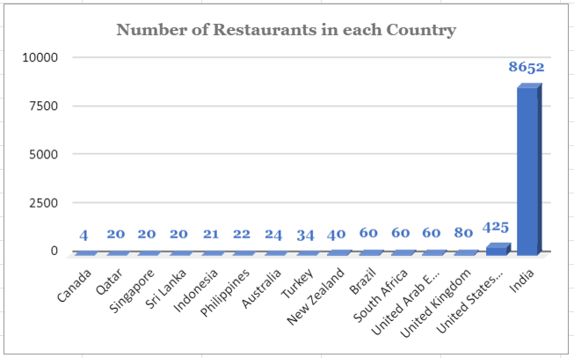
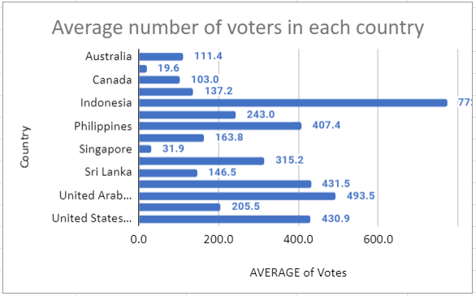
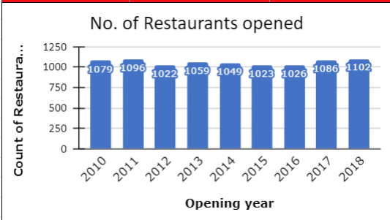
Findings for Objective questions
There are total 9542 restaurants spanned across 15 countries.
Among 15 countries, India has the highest number of restaurants with 8652 establishments.
In India there are total 388 restaurants in the price range of 4.

Slide 6
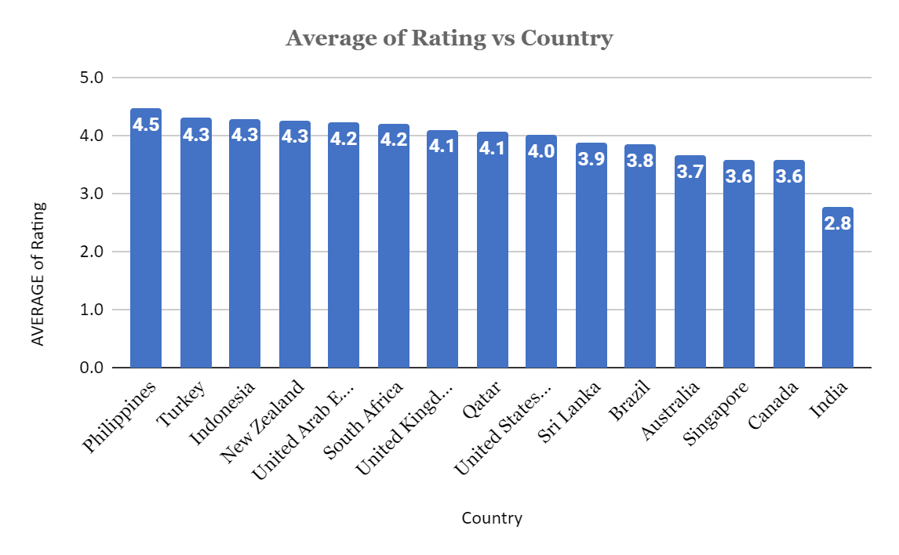
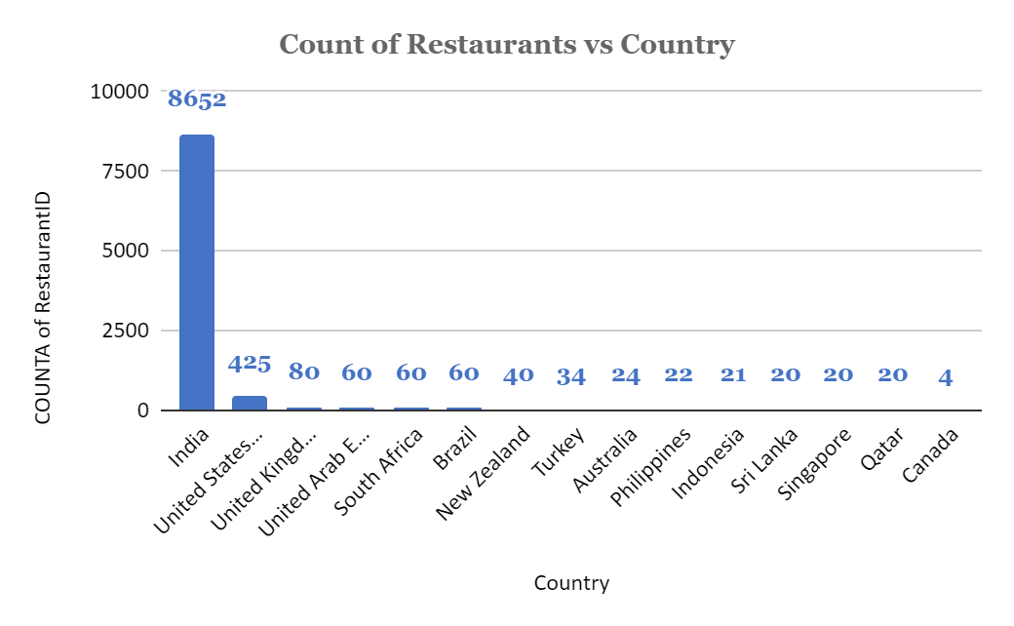
Insights from Subjective questions
Visualizing count of restaurants in the each countries in the column chart reveals the competition in these markets.
Illustrating ratings of the restaurants in these countries provides insights into the quality and standard of establishments.
Analyzing number of restaurants, ratings of the food, cost of two, and considering the insights gained, countries like India, Canada, Australia, Sri Lanka and Singapore are recommended to explore opportunities for new restaurant concepts to stand out and attract a larger market share.

Slide 7
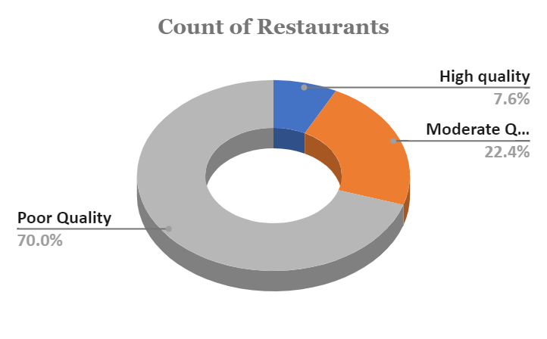
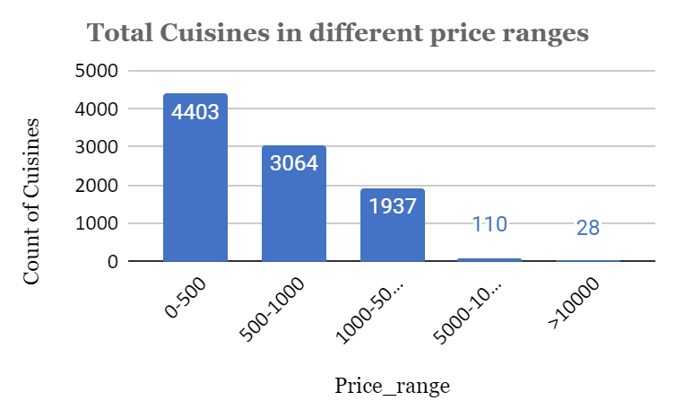
Insights from Subjective questions
In the suggested countries, there are 7.6% high quality restaurants indicating strong sense with consistently high quality offering.
There are 22.4% of the restaurants with moderate quality reflects mediocre service.
70% of the restaurants with poor quality reflects diverse of ratings.
Visualizing variety cuisines across different countries, we see that highest number of cuisines are of price range of 0-500.

Slide 8
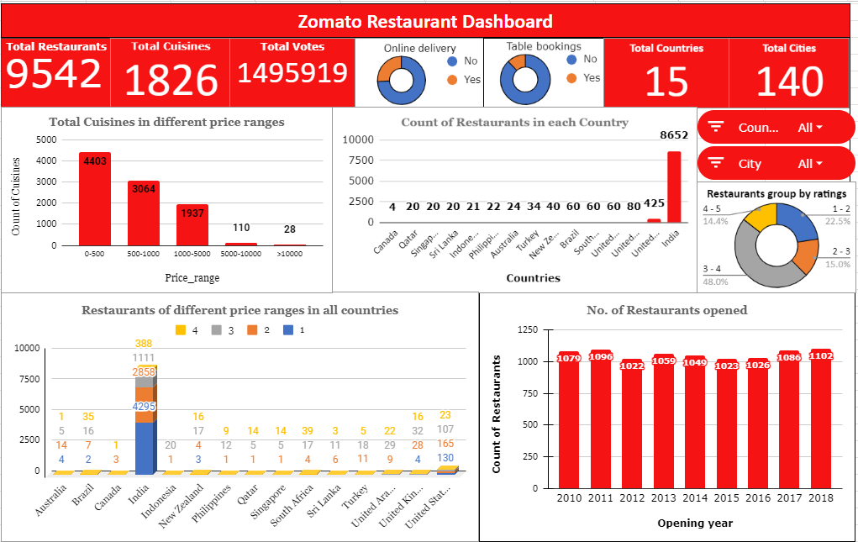
Zomato Restaurant Analysis Dashboard

Slide 9
Conclusion
The dataset gives distribution of restaurants across different countries.
Certain countries exhibit higher levels of competition characterized by large number of establishments and price ranges.
Ratings varies restaurant qualities, online delivery options, table booking option, cost and wide variety of cuisines.
Based on analysis recommendations can be made for strategic expansion in the market.

